Slide 1



Modern Front-end Development with Vue.JS
Galih Pratama
Head Front-end Developer at

Slide 2
Who are you?

Slide 3




Galih Pratama
Front-end Developer with 30+ web/apps developed.
Tech-based Edu Content Creator with 100+ videos created, since 2011.
Current Work / Projects

Slide 4
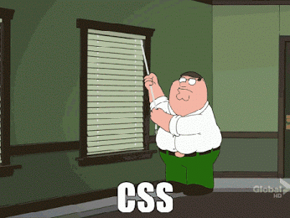
Me in a nutshell

Slide 5
Current State of Javascript

Slide 6
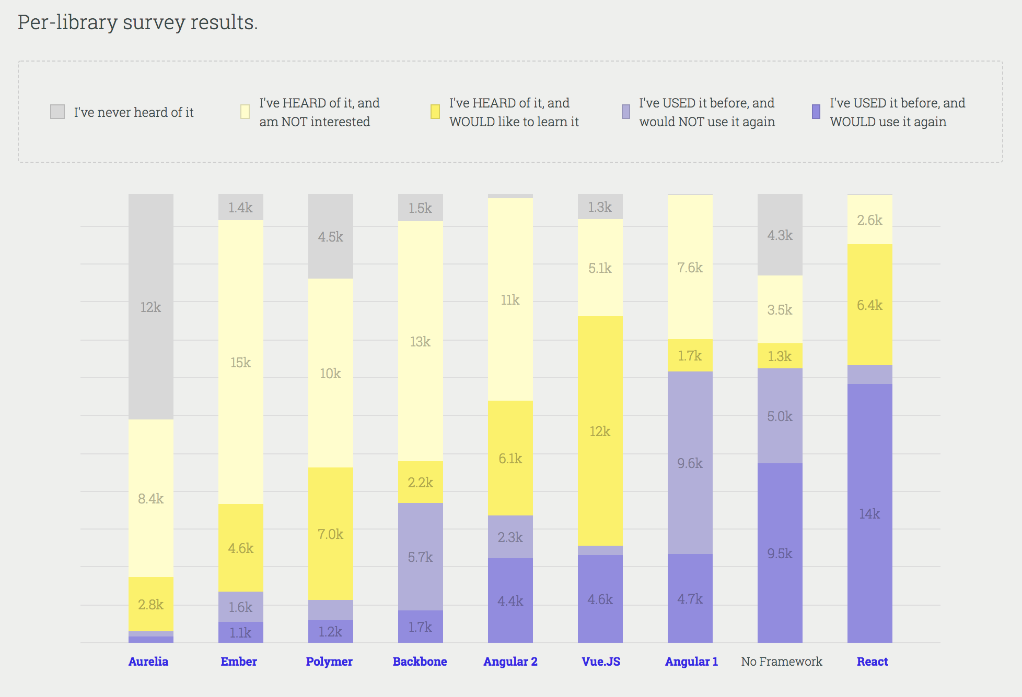
stateofjs.com/2017/front-end/results

Slide 7
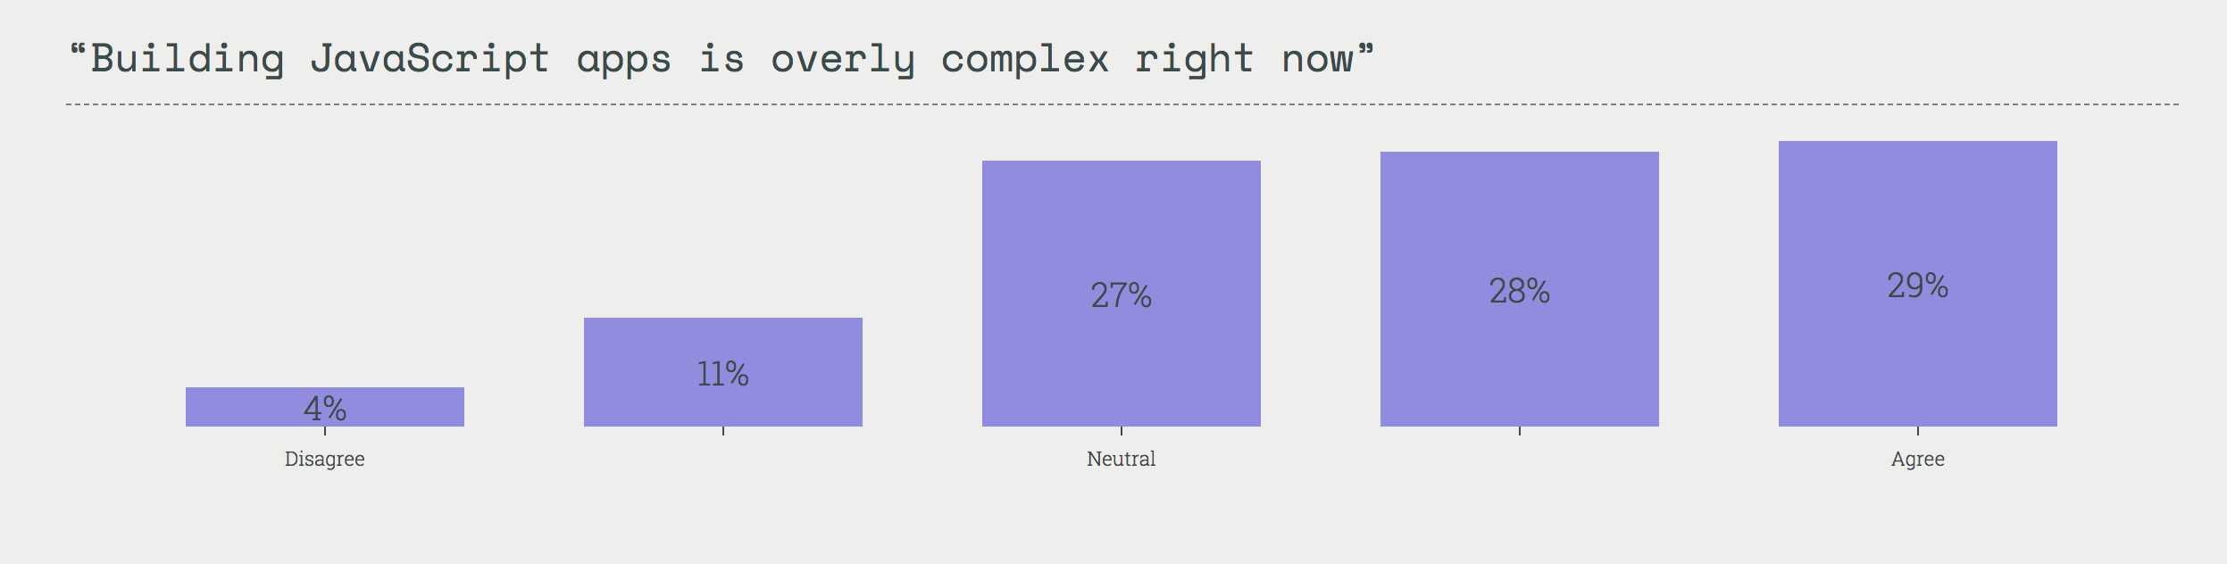
stateofjs.com/2017/opinions

Slide 8
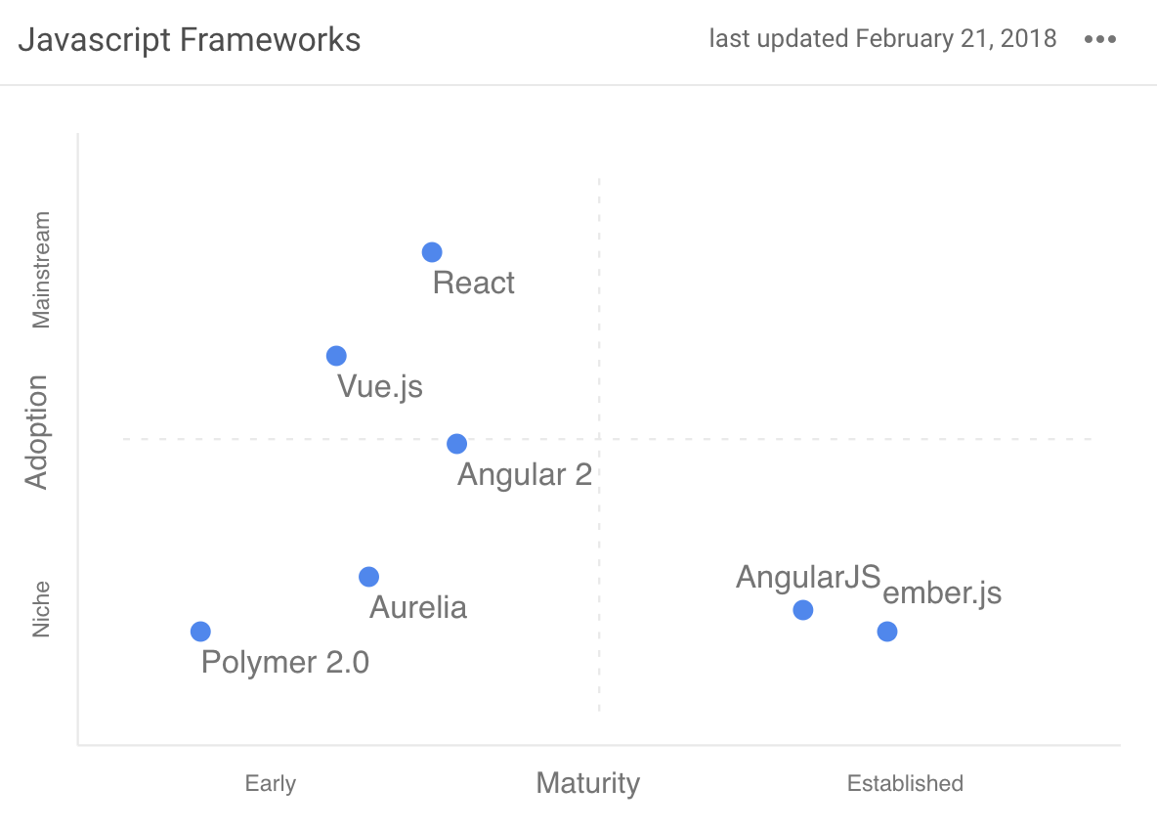
stateofdev.com/c/frontend

Slide 9
What is “Modern Front-end Development” means?

Slide 10
Improve development speed

Slide 11
Decrease future technical debt

Slide 12
Modular

Slide 13
Good programming pattern

Slide 14
Not over-engineering things

Slide 15
Easy

Slide 16


Slide 17
Why Vue.JS?

Slide 18
Learning curve is easy
Simplicity
Hot reload
Write HTML like an usual
Flexible
Single page apps
Vue Devtools
Can used on existing app
Small file size
Less boilerplate code
Fun
Two-way data binding
Vuex
Detailed documentation
Reactive
vue-cli

Slide 19
Single Page Apps (SPA)

Slide 20
Why SPA?

Slide 21
App rendered in browser

Slide 22
Less server overhead
(no need to render anything in server, only serve html/css/js)

Slide 23
Separation of Concerns
(frontend do frontend, backend do backend)

Slide 24
Fast

Slide 25
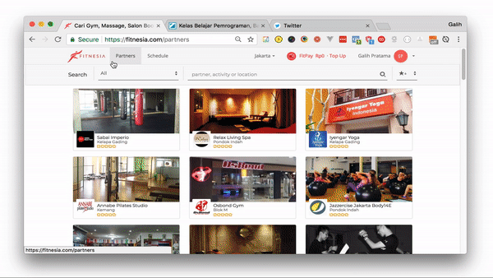

Slide 26
Vue Devtools
Makes developing on Vue.js even easier than it already is.

Slide 27
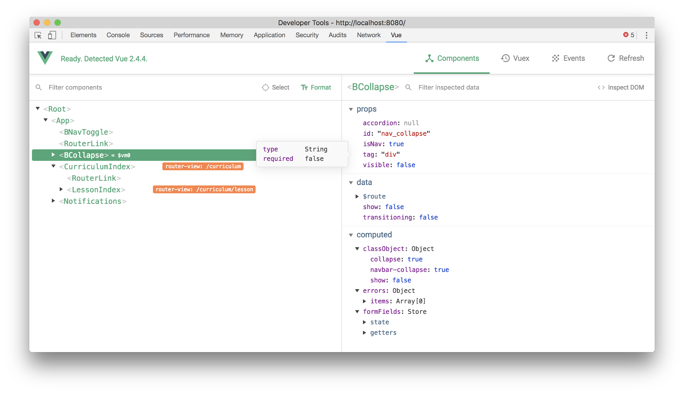

Slide 28
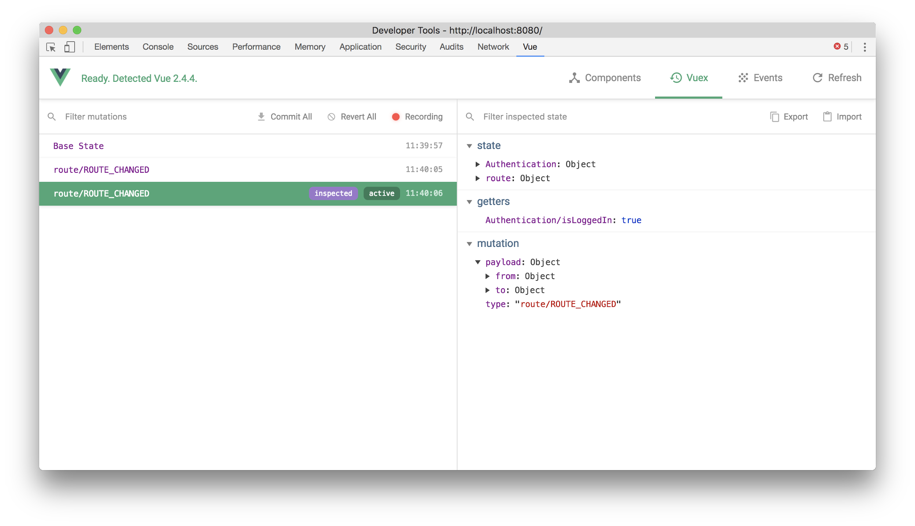

Slide 29
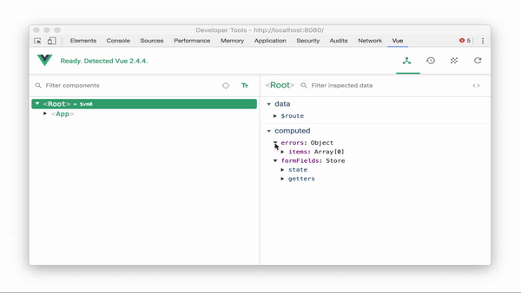

Slide 30
vue-cli
A simple CLI for scaffolding Vue.js projects.

Slide 31
vue init <templatename> <projectname>

Slide 32
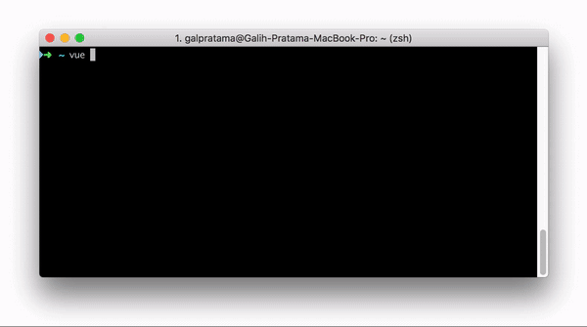


Slide 33
You can use it in any way!
webpack A full-featured Webpack + vue-loader setup with hot reload, linting, testing & css extraction.
webpack-simple A simple Webpack + vue-loader setup for quick prototyping.
browserify A full-featured Browserify + vueify setup with hot-reload, linting & unit testing.
browserify-simple A simple Browserify + vueify setup for quick prototyping.
pwa PWA template for vue-cli based on the webpack template
simple The simplest possible Vue setup in a single HTML file

Slide 34
SEO?

Slide 35
Google(bot) can index Single Page Apps

Slide 36
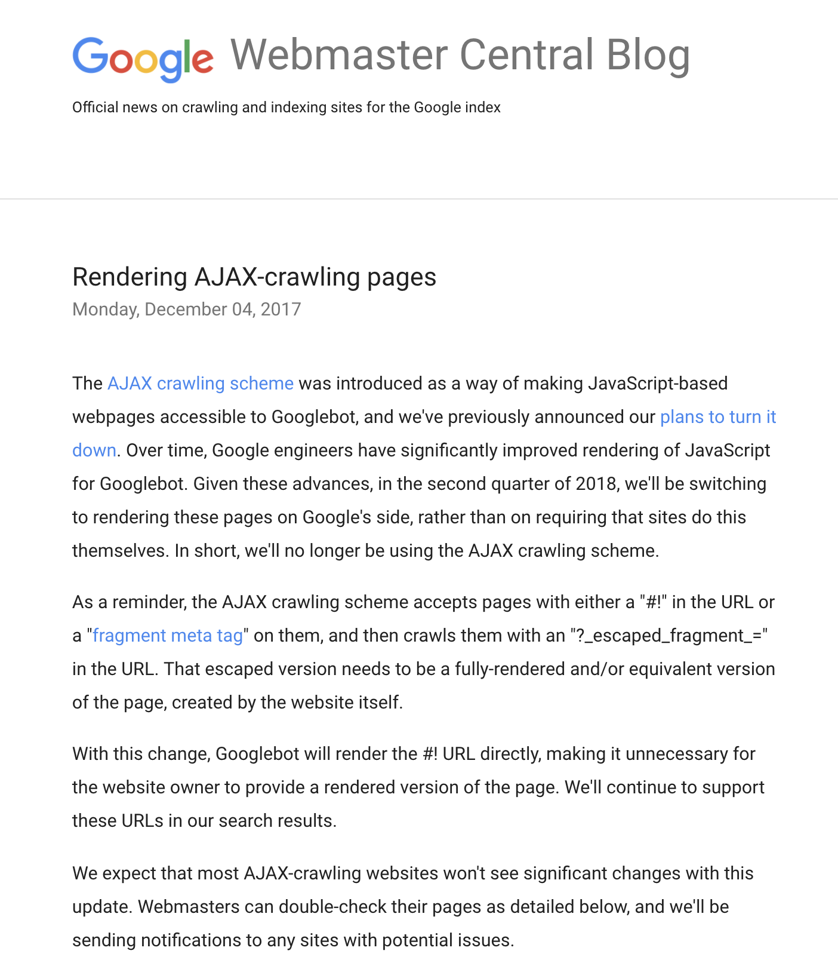
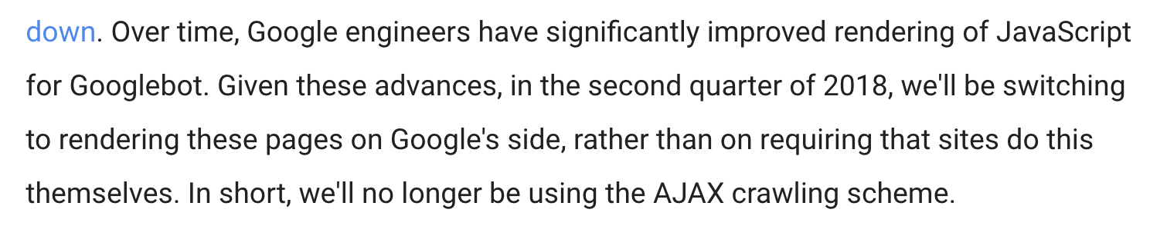

Slide 37
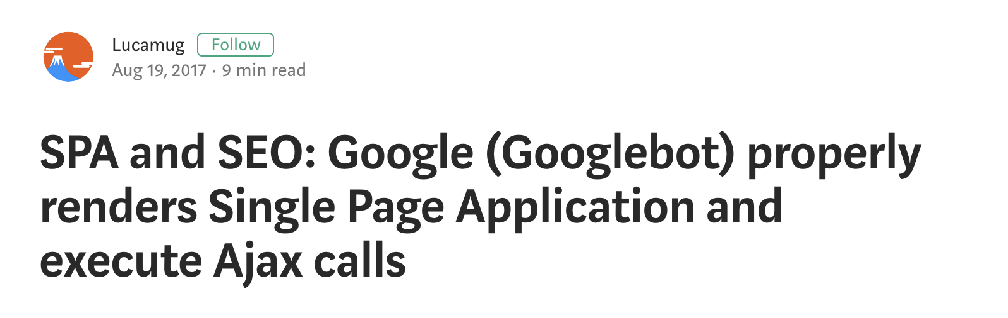

Slide 38
SPA & Googlebot
Googlebot run the Javascript on the page and the Ajax calls are properly executed
Googlebot waits between 5 to 20 seconds before taking a snapshot of each page
More : https://medium.com/@l.mugnaini/spa-and-seo-is-googlebot-able-to-render-a-single-page-application-1f74e706ab11

Slide 39


Slide 40
Nuxt.js
Vue.js with Steroids and Server-side rendering support

Slide 41
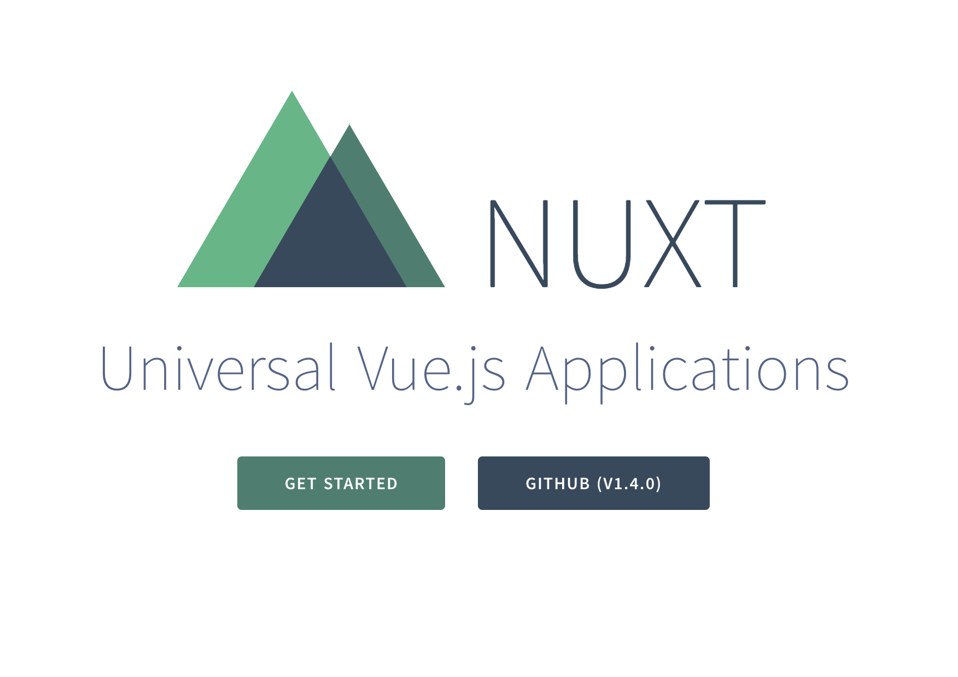

Slide 42
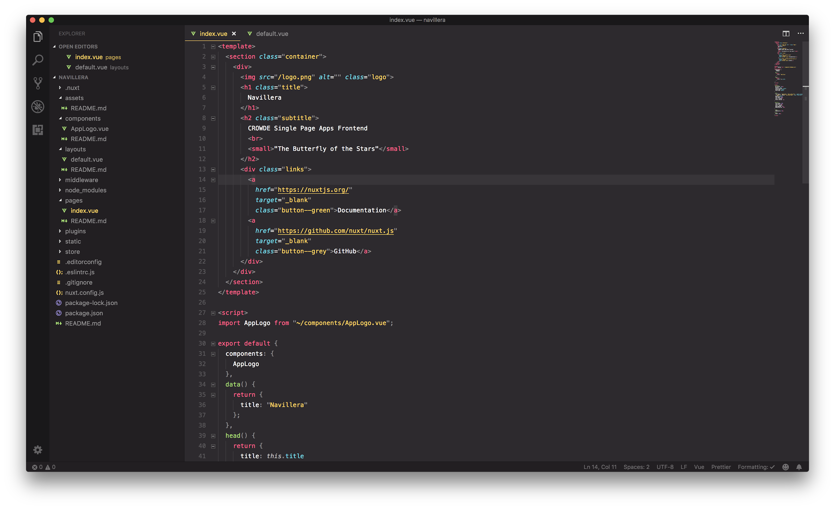

Slide 43
Features
Write Vue Files (*.vue)
Automatic Code Splitting
Server-Side Rendering
Powerful Routing System with Asynchronous Data
Static File Serving
ES6/ES7 Transpilation

Slide 44
Features
Bundling and minifying of your JS & CSS
Managing <head> element (<title>, <meta>, etc.)
Hot module replacement in Development
Pre-processor: Sass, Less, Stylus, etc.
HTTP/2 push headers ready
Extending with Modular architecture

Slide 45
Vuetify
Beautify your Vue.JS application with Material Design

Slide 46
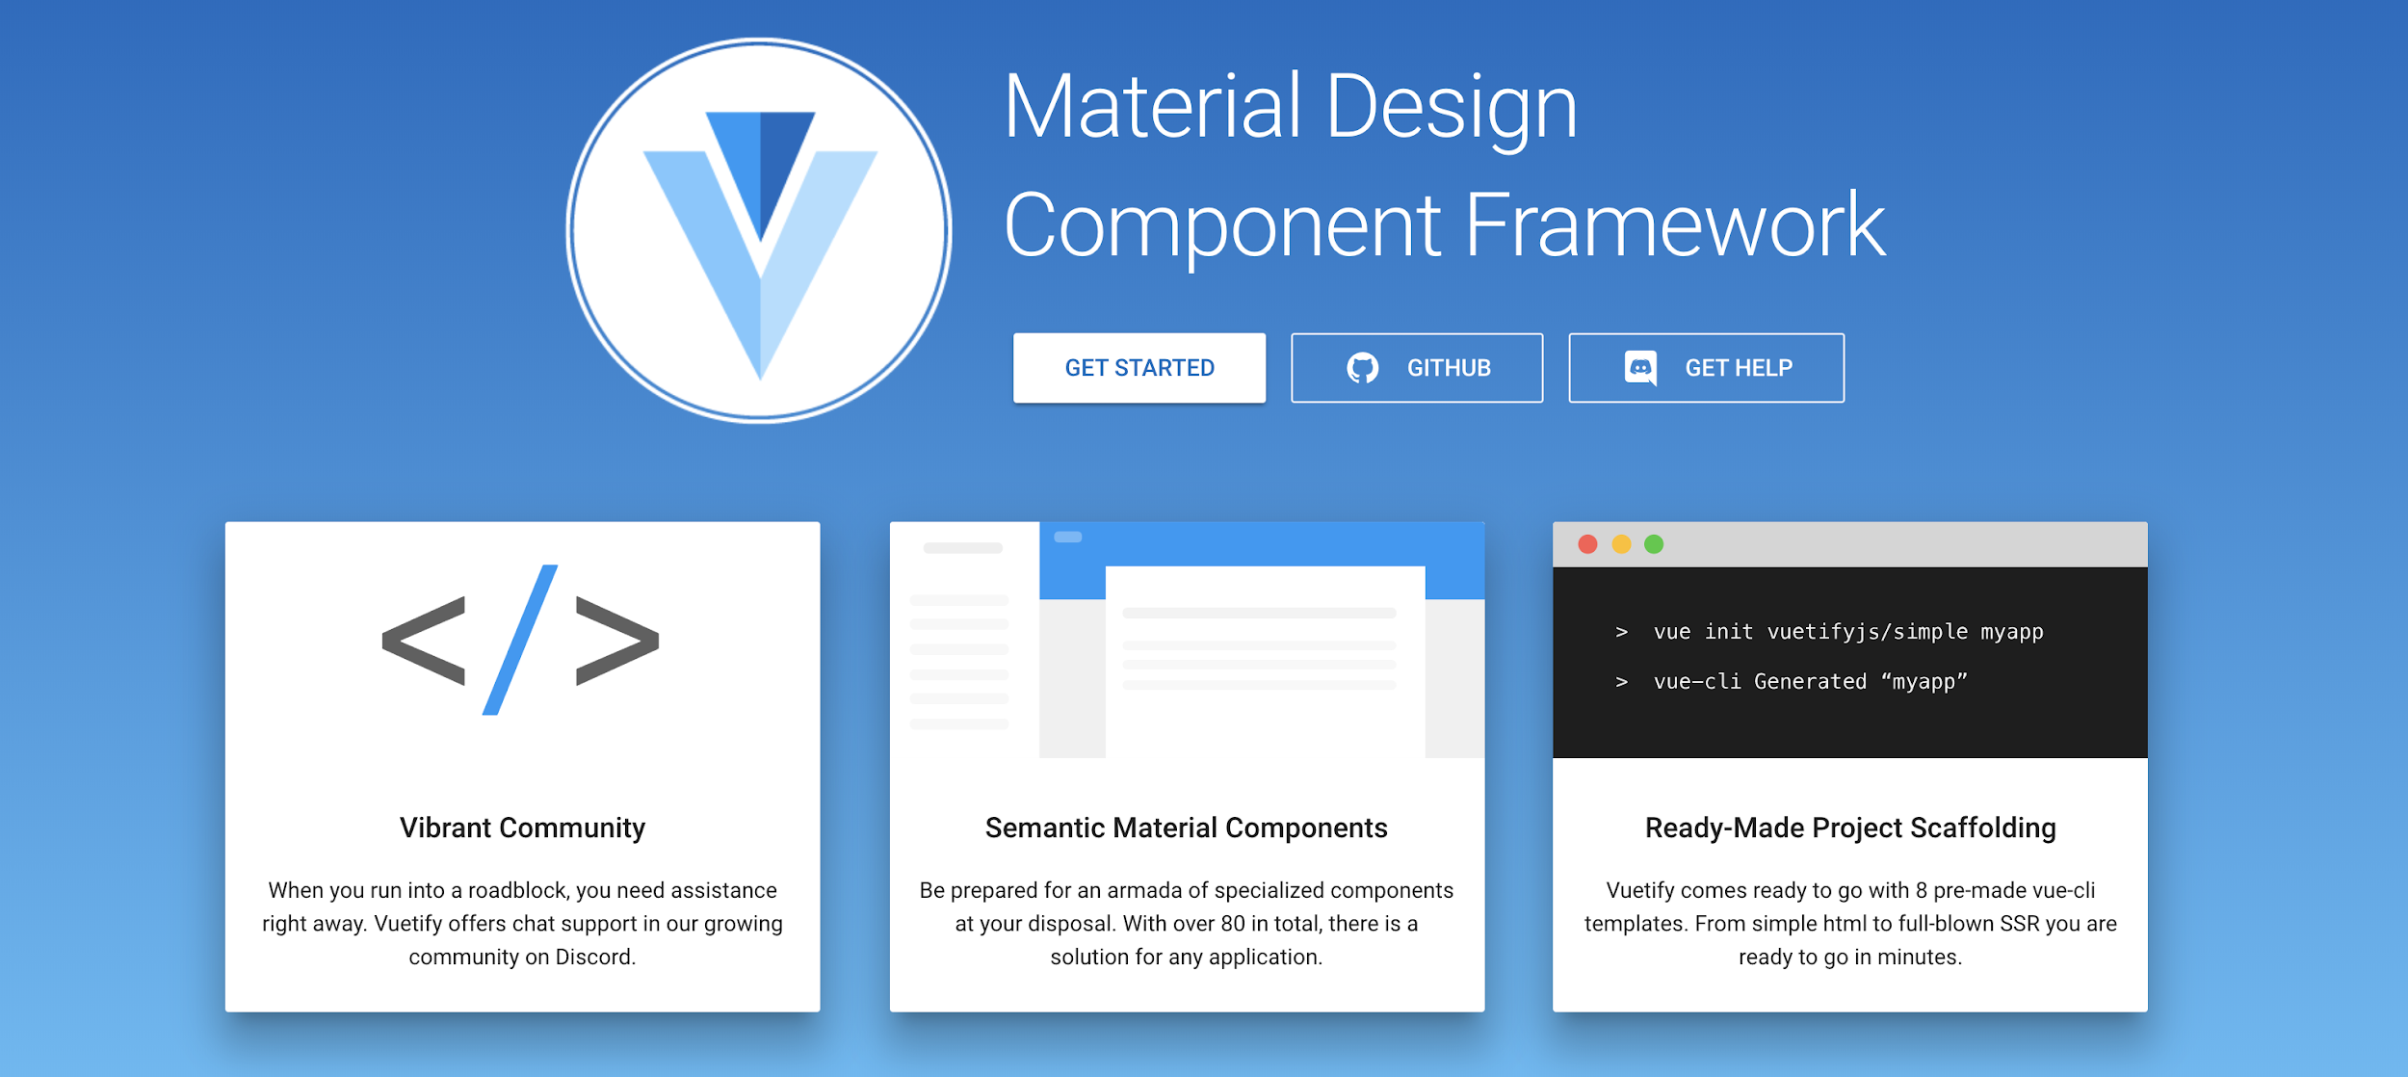

Slide 47
Follow Material Design Guidelines

Slide 48
Follow Material Design Guidelines

Slide 49
You can build apps fast

Slide 50
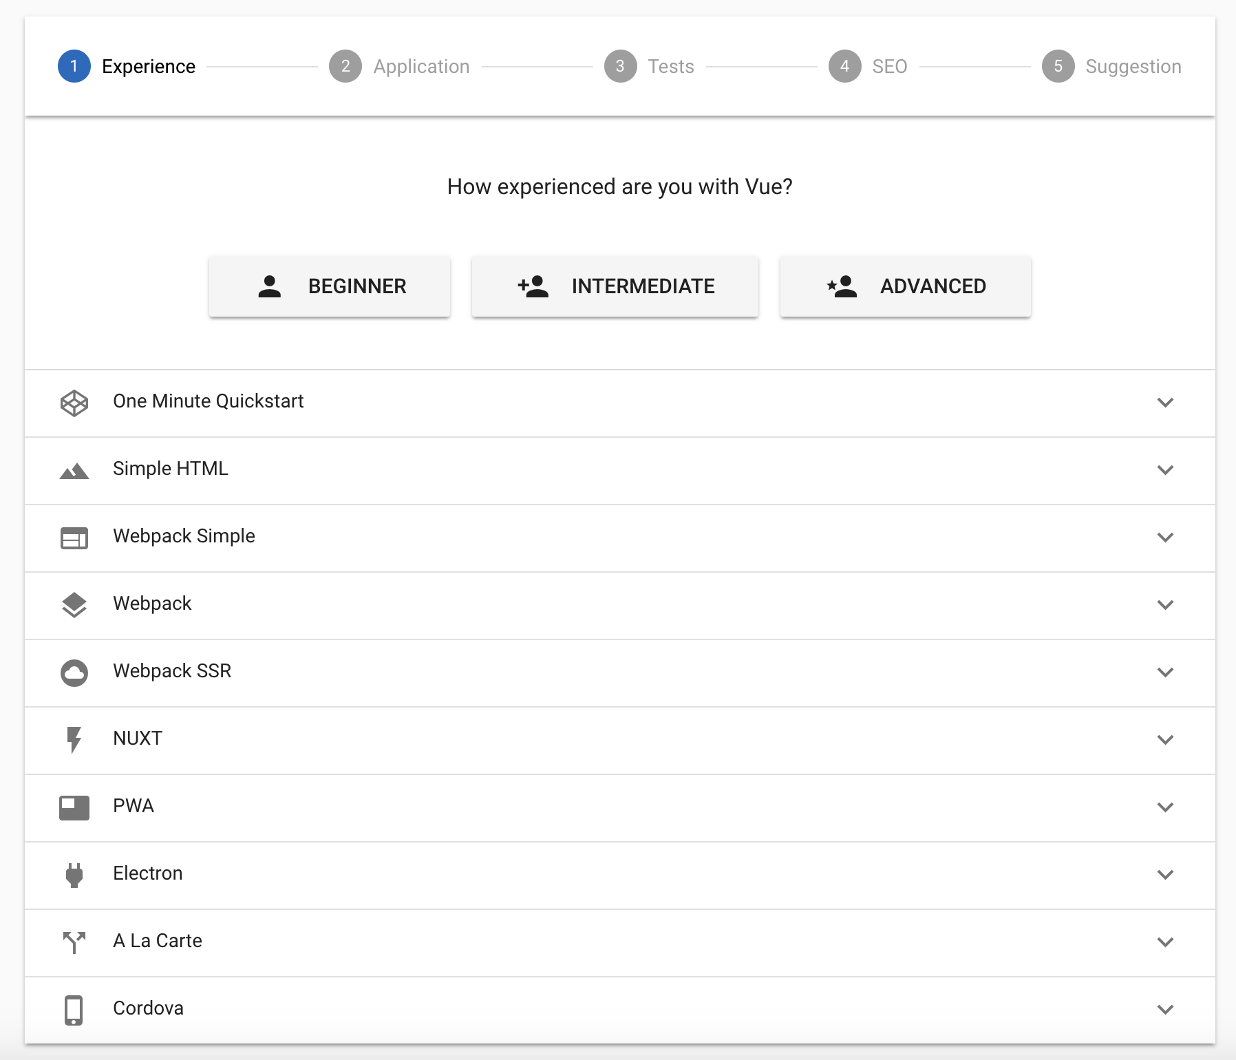

Slide 51
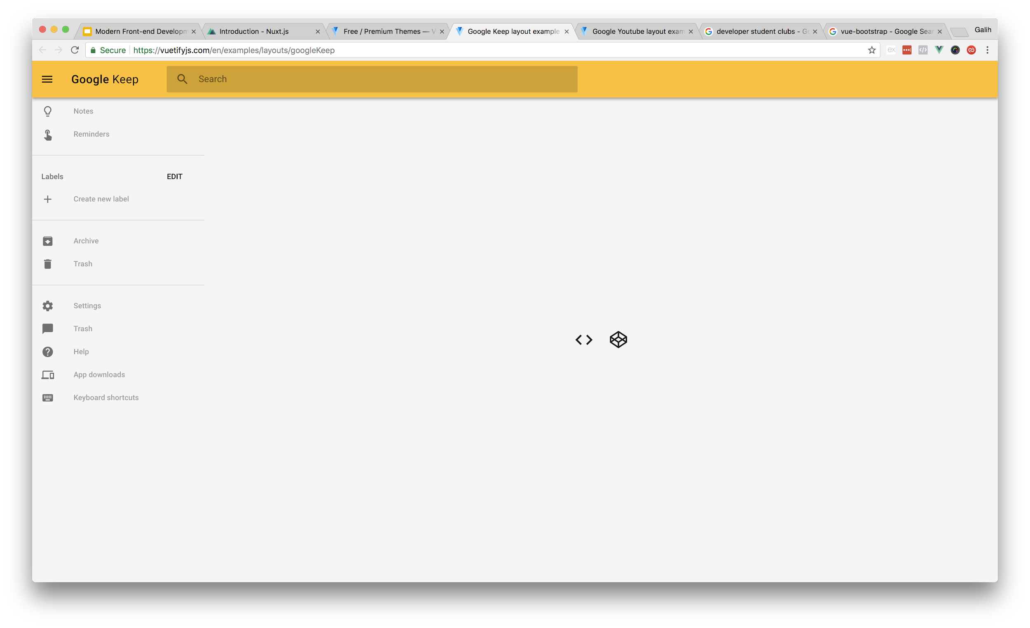
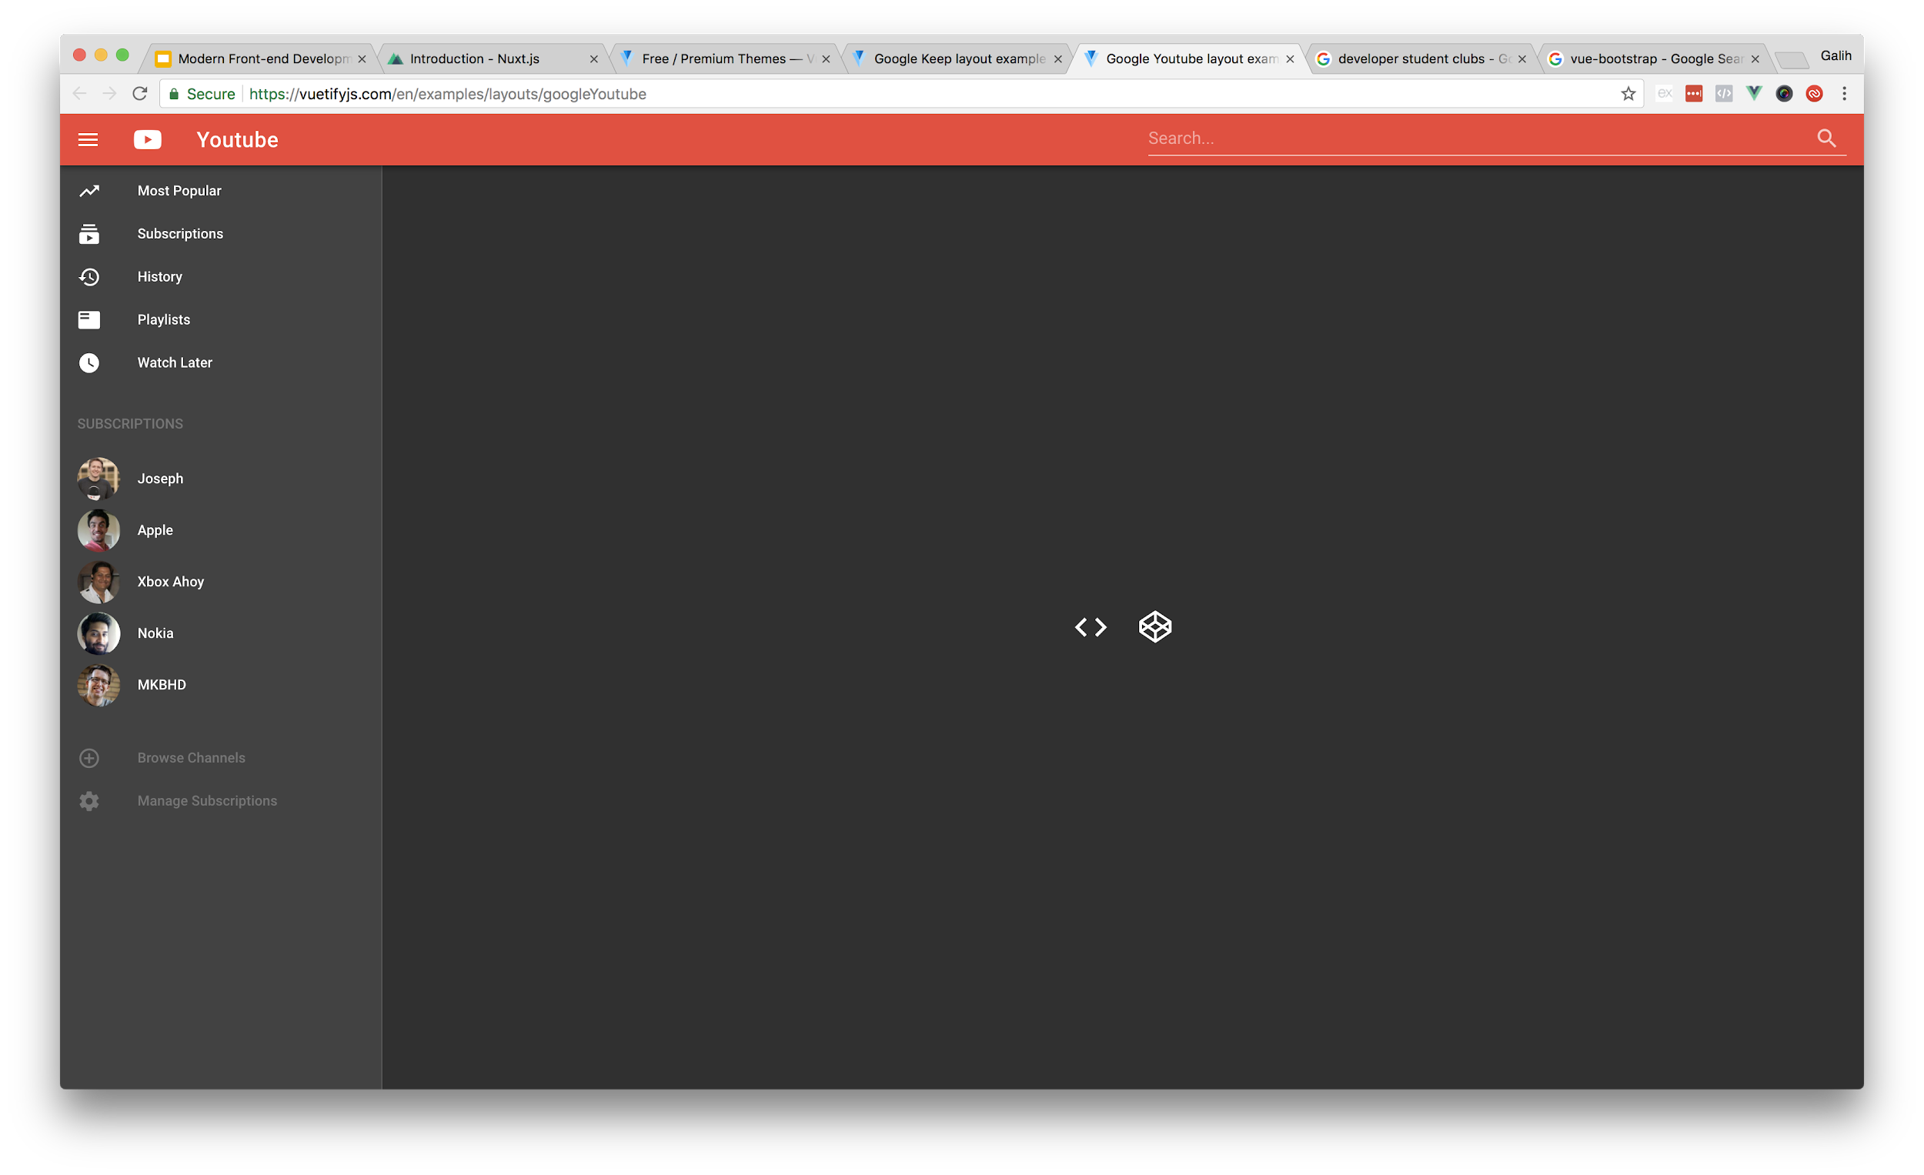

Slide 52
Theme Generator

Slide 53
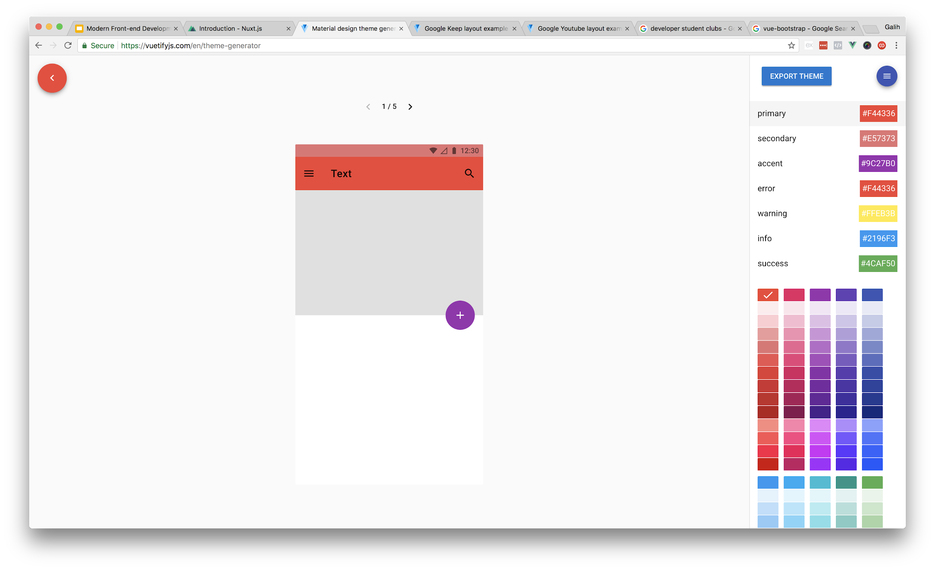

Slide 54
Conclusion

Slide 55
Conclusion
Building javascript apps is somewhat confusing
Vue.JS make it easier without sacrificing scalability.
Official project generator using vue-cli
Ready to use devtools with zero configuration
SEO is safe (like Google said)
Nuxt.js is one of framework that can use server-side rendering capabilities
Want to use material design? Use Vuetify

Slide 56
Thank….

Slide 57
… one more thing

Slide 58
You can learn that if you join Developer Student Clubs

Slide 59



Thank you!
galpratama
pratama.galih
hi@galihpratama.net

